Slide 1

IPaT Spring Townhall
January 15, 2015

Slide 2
IPaT Spring Meetings
IPaT Townhall: Jan 15
IPaT Campus Advisory Board
March 10 11-12:30
IPaT All Hands
Feb 17 and Apr 28 11-12:30
IPaT Research Directors Meetings
Jan 27, Feb 24, Mar 27, Apr 24
8:30-10 am
Annual Research Survey
Week of Feb 23
Spring Research Showcase: Apr 15
CIC Showcase and Judging: Apr 16
Hackbreak: March 16-20
Thursday Think Tanks
Thursdays, 3:30-5
IPaT Development Mtgs
Weekly: Thursdays 9:30-10:30
Monthly: Health Partnerships

Slide 3

Seed Grant Opportunities
Digital Policy: Communication Tools to Shrink the Science to Policy Gap
Nassim JafariNaimi, School of Literature, Media, and
Communication
Kim Isett, School of Public Policy
The Move Lab: a STEAM Community of Learners
Betsy DiSalvo, School of Interactive Computing
Al Matthews, Eyedrum
Onar Topal-Sumer, Eyedrum
Exploring Movement-Based Games to Encourage Social Behaviors in Children with Autism
Agata Rozga, School of Interactive Computing
Brian Magerko, School of Literature, Media, and
Communication
Ashley Cheek, The Lionheart School
Victoria McBride, The Lionheart School
Patients’ Information Needs Related to Diagnostic Processes around Health Concerns
Lauren Wilcox, School of Interactive Computing
Munmun De Choudhury, School of Interactive Computing
Aarti Sekhar, Emory Healthcare
Wearable Technology Exhibition Digital and Literary Extension
Clint Zeagler, School of Industrial Design
GVU: new round in May 2015
CHOA: new round in Feb 2015
Wearable Computing
CDC

Slide 4

Seed Grant Opportunities
GVU: new round in May 2015
CHOA: new round in Feb 2015
Wearable Computing
CDC
Automatic and Early Detection of IV Infiltration using Non-Invasive Sensing
Omar Inan, Russell McCrory, Leanne West, Renee Watson, Lynn Pogue
Optimization of the algorithms for screening for critical congenital heart disease
Pinar Keskinocak, Turgay Ayer, Matthew Oster, Scott Grosse
Effectiveness of Rhythmic Auditory Stimulation in Virtual Reality Games for Improving Upper-Arm Function in Children with Cerebral Palsy
Yu-Ping Chen, Barbara Weissman, Ayanna Howard
Utilization of Diagnostic Radiology Reports by Pediatric Patients’ Family Members
Lauren Wilcox, Steven Simoneaux, Aarti Sekhar

Slide 5

Seed Grant Opportunities
GVU: new round in May 2015
CHOA: new round in Feb 2015
Wearable Computing
CDC
NaturalMotion: Intuitive Gesture Control and Visualization of Time-Evolving Graphs
Polo Chau
Smart Ballet Shoe
Jim Budd
Multi-sensory Mirror Therapy Gloves
Jim Budd
Human Body Mediated Communication
Gregory Abowd
ONSCENT
Melody Moore Jackson:
Pehn Pehn Pixels
Jim Budd
Wearable Computing in the Wild
Keith Edwards
Notes:
Need list of winners

Slide 6

Seed Grant Opportunities
GVU: new round in May 2015
CHOA: new round in Feb 2015
Wearable Computing
CDC
Assessing Adherence to Evidence based Care Practice for Children Diagnosed with ADHD in the Medicaid System
GT - Kelly Bartlett, Nicoleta Serban, Julie Swann CDC – Melissa Danielson, Susanna Visser, Scott Grosse, Roseanne English
PTT AdvisorPlus: Development and Evaluation of a Clinical Decision Support Tool Mobile Application for Management of Anticoagulants
GT - May Wang CDC – Barbara Zehnbauer
Text Messaging to Improve Asthma Outcomes in Minority Persons with Asthma
GT - Rosa Arriaga CDC - Suzanne Beavers
Not One More Life - Leroy Graham
Notes:
Need list of winners

Slide 7
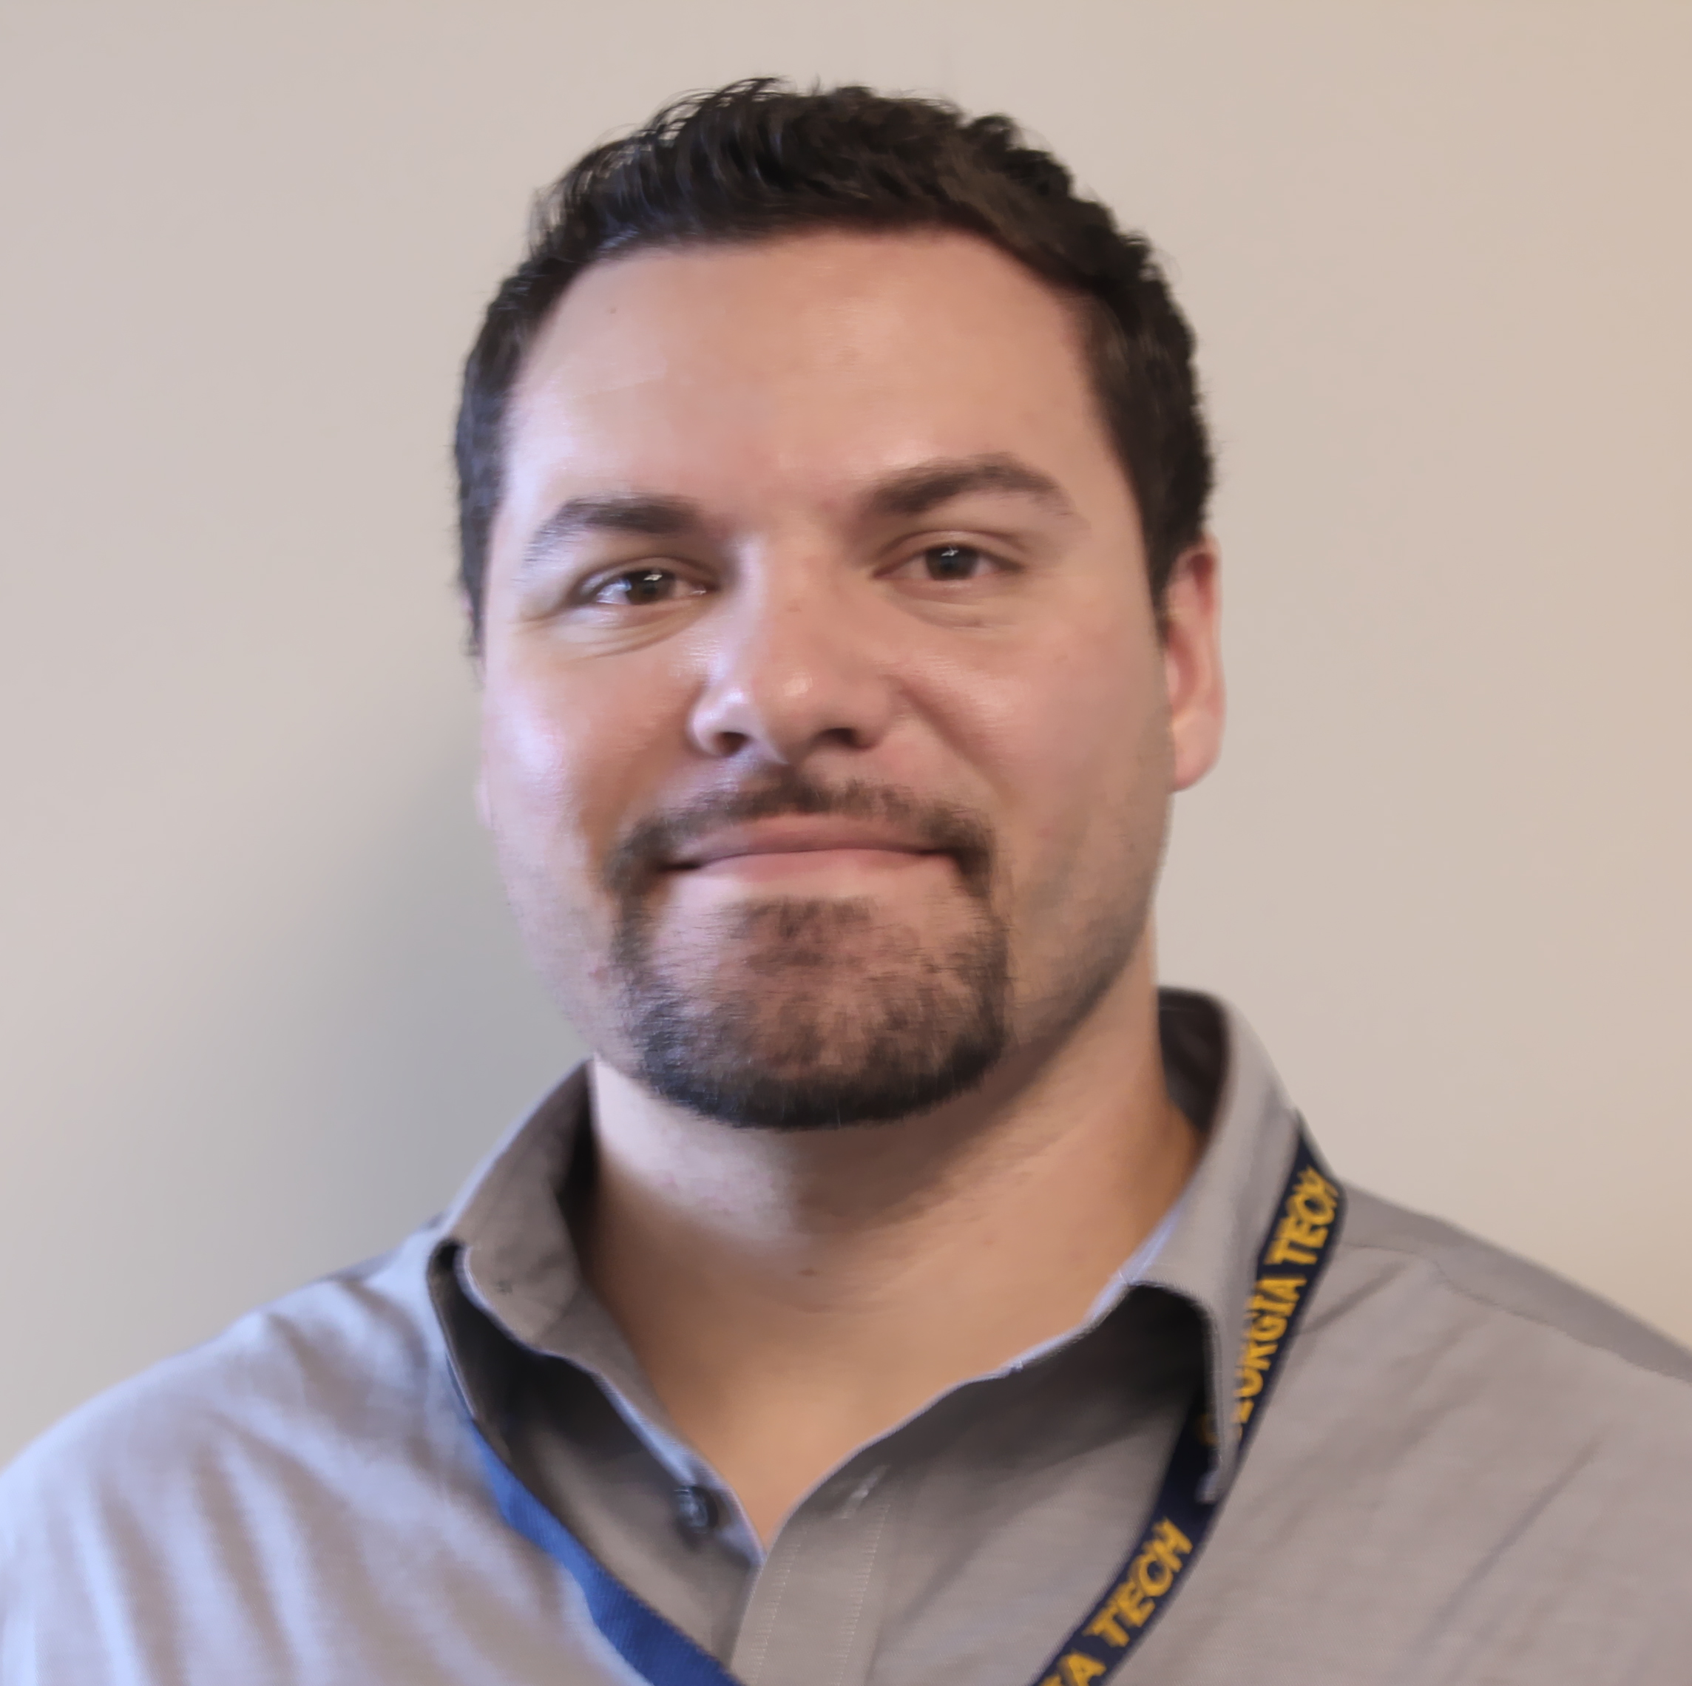

Only Constant is Change
Mynatt takes role as vice-chair of the CCC
LeDantec now IPaT Assistant Director
Farrugia now IPaT Managing Director,
Health Research Partnerships
Jayaraman now Project Manager, IPaT Development
Schoner now managing IPaT events and HQ suite
Hutchins takes new responsibilities;
reporting to the EVPR
RNOC moving to IPaT
Raul Perez joins as IPaT Graphic Designer
Richard Starr joins as IPaT Health Data Management
Now hiring IT / web development

Slide 8
IPaT Spring 2015 Priorities
Health: Pediatrics
Aging
State partnerships
Major federal proposals
Protected health data
Analytics + Mobile +
Interoperability
Media: Wearable computing
AR + Argon
Making + STEM
Whole house gaming
Humanitarian: Nobel Summit
Midtown and City of Atlanta
HPCC: Urban Sustainability
Internet of Things
Education: STEM Incubator
Partnership with Atlanta Public
Partnership with Dept of Ed
Enterprise Transformation: Computational Enterprise Analystics
Short courses (national expertise)
Complex system modeling
Annual Research Survey: Week of Feb 23 Annual Research Survey: Week of Feb 23 Annual Research Survey : Week of Feb 23

Slide 9
Focus on Partnerships
Criteria for a good partner
Leadership
Critical resources
Multi-disciplinary approach
Agile combination of
  basic research
  applied research
  economic dev
  talent development
Multi-sided partnerships
Examples:
ACT
“Rome project”
Gov Office of Student Achievement
Opportunities
Asset for national centers
Sustainability
Seed projects and “Quick Wins”
Notes:
Gov Office of Student Achievement Innovation Fund Scaling Up Grant- (expands existing ENGAGES Project with BEST and CSK schools with a focus on just CSK (girls) and partnering with CEISMC for GIFT- ($199,000 for 2 years).
Mindy and I will be hosting a kick off meeting in late January.

Slide 10
Focus on Partnerships
Today’s highlights:
Georgia P12 Schools
GA STEM Incubator
Health IT Showcase
UCB (Pharmaceuticals)
Wearable Computing Center
Samsung (visitors program)
City of Atlanta
Steelcase
Nobel Peace Laureates Summit …
Center for Global Enterprise (CGE)
CDC
Children's Healthcare of Atlanta
Planning for the upcoming HPCC building with a focus on Urban Sustainability
Updates on support for Protected Healthcare Data
Updates on SimTigrate partnerships
Updates on this year's Convergence Innovation Competition (CIC)

Slide 11

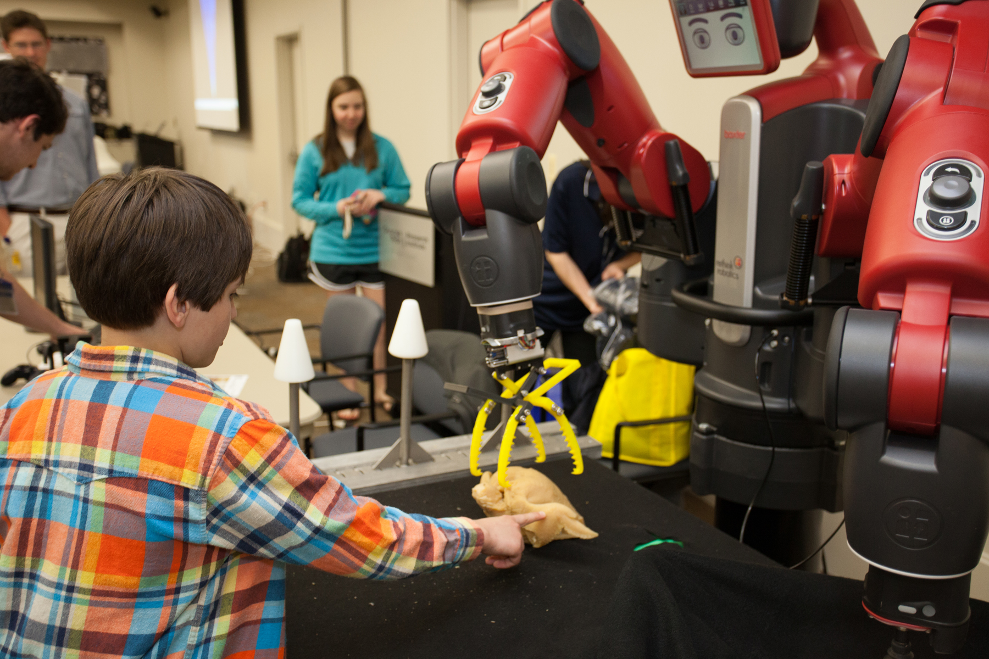
Finding, Focusing, Facilitating, and Sustaining Meaningful Post-Secondary Partnerships with Georgia P12 Schools
Finding Partnerships
Focusing Partnerships
Facilitating and Sustaining Partnerships
Partnerships
Georgia Department of Education
Governor’s Office of Student Achievement
Georgia Student Finance Commission
USDA
Foundations: AVD, Zeist
Local Education Agencies, such as:
Ridgeland High School (Walker County)
Ware County High School
Sandy Springs Education Force
Jackson Cluster
BEST and CSK High Schools
Leigh McCook, Leigh.McCook@gtri.gatech.edu
Notes:
Meaningful sustained partnerships versus one day events
Partnerships are focused with goals and objectives
Goal of doing meaningful things with teachers and students
Sustained dialogue two way from the beginning of the partnership, continuous check in during and at the end of the project

Slide 12

Georgia STEM Incubator funded by the Governor’s Office of Student Achievement
Statewide resource for teachers, school leaders, and STEM stakeholders
Nurture and support Georgia’s P12 STEM education and outreach
Diverse public/private partnerships
  Real world internships and mentoring
  Coach STEM teams
  Teach STEM content area classes
  Host STEM tours
  Volunteer in afterschool and summer programs
  Provide STEM-focused funds and resources
Leigh McCook, Leigh.McCook@gtri.gatech.edu

Slide 13

I3L / GT Healthcare Partnerships

Slide 14
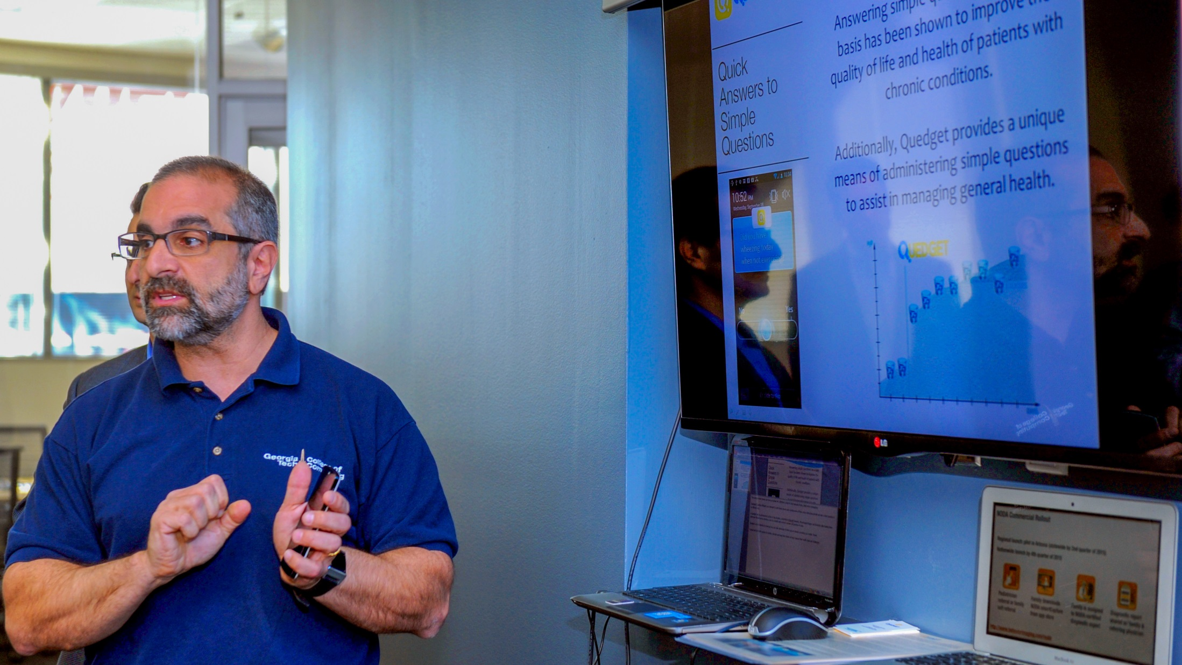
Showcasing in Support of Faculty / Sponsored Research and Industry Partners / Startups
.

Slide 15

UCB – GT/I3L Partnership
.
Mark Braunstein: “The ultimate goal of the partnership is to develop an interactive system that can convert large amounts of anonymous patient data into real-time insights healthcare providers can consult at the point-of-care to inform treatment decisions.”
Jeff Wren, President of UCB North America: “By marrying big data and predictive analytics, we may be able to develop a system that physicians can consult in the clinic to help provide more personalized epilepsy treatment selections.”
Chris Clark, UCB New Journey Board Member / Sponsor: “If this works it will transform the delivery of care for epilepsy patients.”

Slide 16

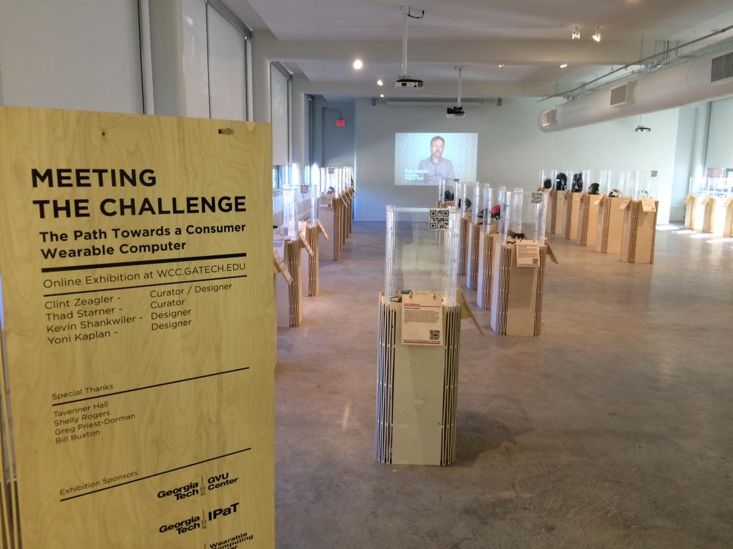
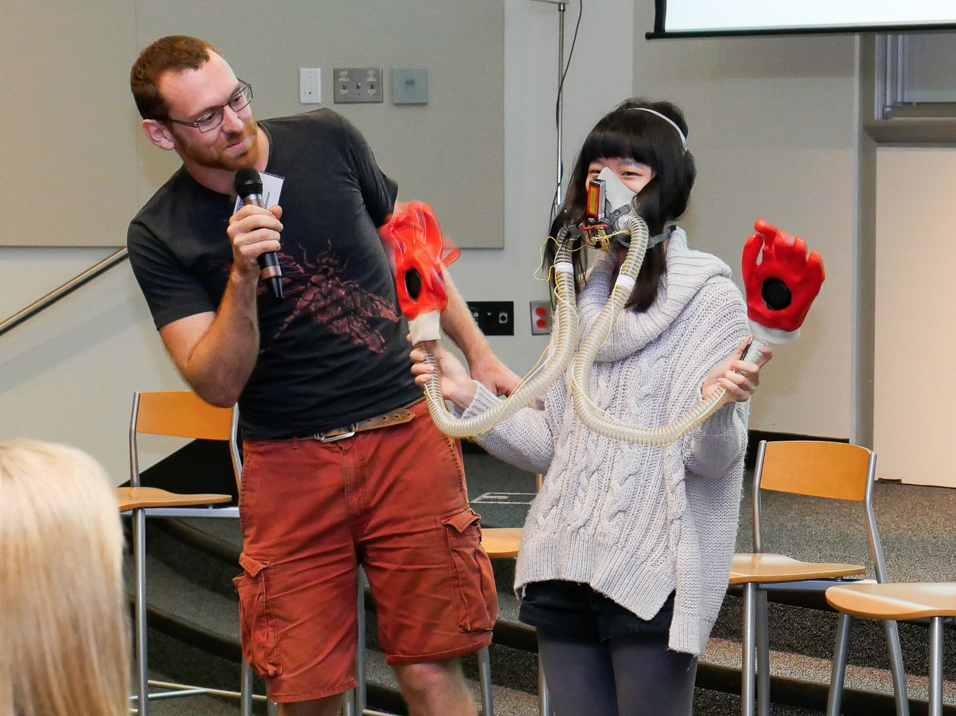
Tackling “Grand Challenges”
  CoC, ECE, LMC, COA, Psych, Pub Pol, GTRI, and IPaT Faculty & Students
Engagement Grant Program
  Seven grants awarded
Research Sponsors
  Google, BMW, GA Dept Ag, Stalker Radar, Coaches Studio, SunJewels
Maribeth Gandy, maribeth@imtc.gatech.edu, wcc.gatech.edu
Notes:
Participation from all around campus, official members from CoC, ECE, COA, Psych, Public Policy, GTRI. Activities include federal and state grant proposals (some already funded). Approaching large companies with interdisciplinary teams (UPS, Sharecare, Coke)
Kickoff stats: ~200 participants. Out of town guests from academia (U Minn) as well as industry (MSR, Jawbone, Fruit of the Loom, John Deere, United Technologies, Thompson Reuters, bunch of startups). Gadget Show, Panel, wearable exhibition reception,
Hosted Round Table industry partners (privacy, security, and policy).
Gave away 7 Engagement grants (profs, grad students, undergrads)

Slide 17

GVU/Samsung Visiting Designer Program
Global Design Power Program
  GT is 3rd partner university, along with Royal College of Art and Politechnico di Milano
~6-8 Samsung designers in-residence for Fall 2015
  Hang out in faculty lab, participate in research, sit in on classes
  GTF resources provided to faculty hosts
Host details due to me by Jan 19
        keith@gatech.edu

Slide 18



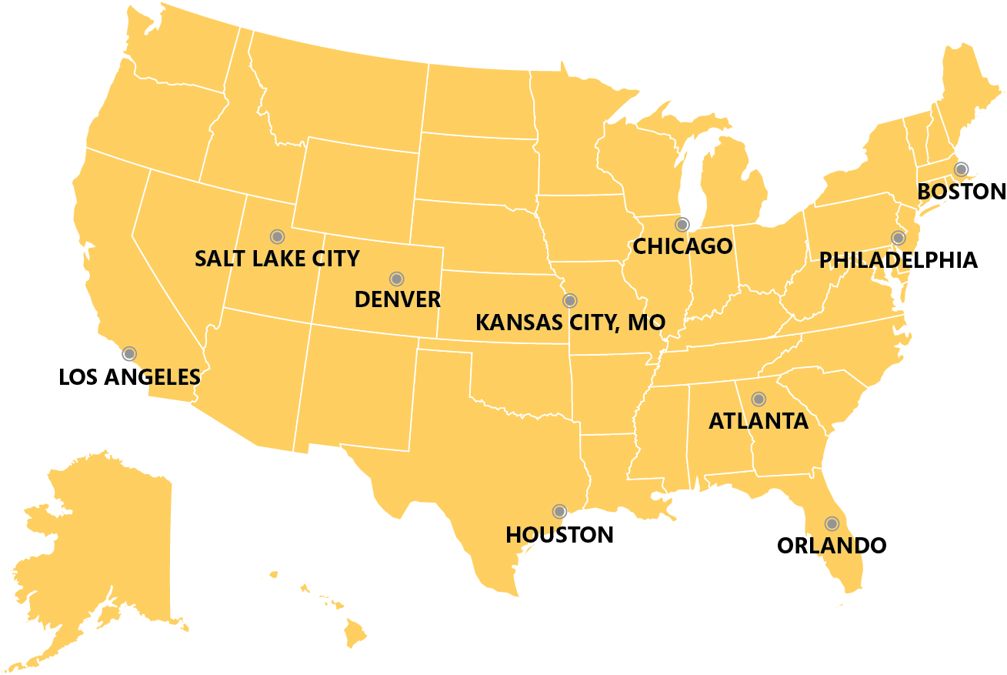
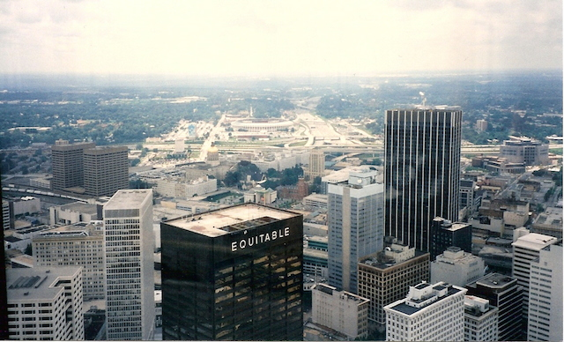
Urban Sustainability Modeling
Expand and develop current work on resilient urban systems funded through the NSF RIPS project
  In partnership with City of Atlanta’s Office of Sustainability and the City Energy Project (10 cities selected nationally)
Expand and develop work with the City of Atlanta’s Innovation Delivery team to develop resilient models of service delivery and management (esp. wireless systems)
FMI contact Jennifer Clark: jennifer.clark@gatech.edu

Slide 19

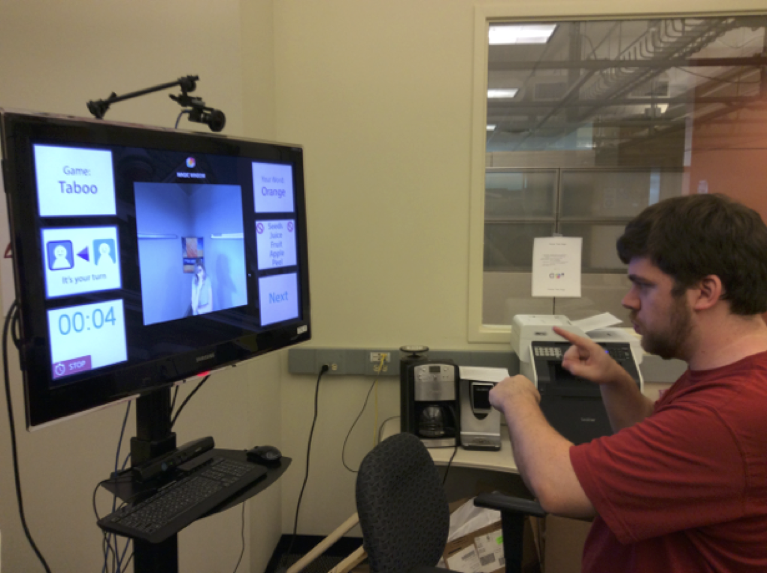
A long, productive history with GT
GVU advisory board
Space planning and design
Numerous, extremely fruitful exchanges
Magic Window
Installation at Steelcase headquarters
Funded user studies
Software Defined Networking
For both operations and future design work

Slide 20

Global Summit on Health-Technology-Education
Finding affordable solutions for urgent social and human problems
Presented by Yunus Creative Lab and the Institute for People and Technology at Georgia Tech
May 10-13, 2015 - Atlanta, GA, USA
The Summit will focus on how technology can be used to provide healthcare and education to the billions who are left out of the current healthcare and education delivery systems
It will be solution oriented and we are inviting businesses, start-ups, and researchers to present their sustainable healthcare solutions as part of an Innovation Showcase
Outcomes from the conference will roll into an action-oriented Nobel Peace Laureates Summit later that year
Prof. Muhammad Yunus
2006 Nobel Peace Laureate
Chairman, Yunus Center
Chairman, Yunus Creative Lab, Inc.
Contact Info: Laurie Dean Baird, Laurie.Baird@ipat.gatech.edu

Slide 21

Computational Enterprise Analytics:
Bringing Visual Analytics to the C-Suite
Rahul C. Basole, basole@gatech.edu

Slide 22
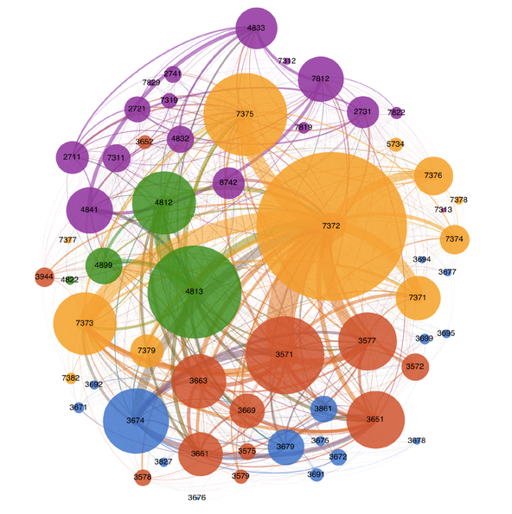
Making Big Data Think Bigger:
1 of 4 Faculty Worldwide (Stanford, NYU, IESE, Georgia Tech)
Design, Develop, and Refine Visual Analytic Tools and Techniques that Help Explore As-Is and To-Be Characteristics of Complex Global Business Ecosystems
Enhance and Augment Strategic Decision Making for Business Leaders Running Large Complex Global Operations
  Sense Making
  Risk Management
  Opportunity Identification
Planned Activities:
  “Think Paper” on State-of-the-Art Tools (Q1/15)
  Study of Wide Data Analytics & Executive Decision Making (Q2/15-)
  CEO Workshop (Q3/15)
  Visual Analytic Platform for Ecosystem Intelligence (Q3/15-)
  Present work at Global CEO Forum in India (Q2/15) & China (Q4/15)
http://bits.blogs.nytimes.com/2014/09/20/making-big-data-think-bigger/
Rahul C. Basole, basole@gatech.edu

Slide 23
Centers for Disease Control and Prevention
16 Capstone Design Projects submitted
2 Vertically Integrated Program (VIP) Project underway
    Predictive analytics using algorithm to sequence 1 disease state (Jimeng Sun)
    Development of an algorithm to improve donor organ matching to decrease rejection (Joel Sokol)
Planning a series of “Drill Down” seminars
  Antimicrobial Resistance (AR)
  Advance Molecular Detection (AMD)
  Global Health Security (GHS)
  Hospital Acquired Infections (HAI)
  Data Visualization (DV)
IPaT Seed Awards
(plan to extend campus wide)
  Assessing Adherence to Evidence based Care Practice for Children Diagnosed with ADHD in the Medicaid System
  PTT AdvisorPlus: Development and Evaluation of a Clinical Decision Support Tool Mobile Application for Management of Anticoagulants
  Text Messaging to Improve Asthma Outcomes in Minority Persons with Asthma
Memorandum of Understanding signed
Continue to explore funding options
Campus-wide Ebola initiative
  Ebola Modeling Workshop 1/22-1/23 Academy of Medicine
Sherry.farrugia@gatech.edu

Slide 24


Children’s Healthcare of Atlanta Update:
6 new Children’s Scholars for 2015
14 seed grants awarded in 2014
5 Quick Wins Awarded in 2014
2 TI:GER Teams 2014
Strategic Vision submitted for next gift
QW Highlights:
  Grasper (West) delivered
  iEAT (Adams) tested & used internationally
  TWMB (Wright) mentioned by Obama in speech
  Asthma Careflow (Basole) published in JAMIA
Join us @ PediatriConnect.gtri.gatech.edu
Leanne West, leanne.west@gtri.gatech.edu

Slide 25

Georgia Tech’s Role in the Urban Innovation Space
Technology
  Proximity to Innovation: we understand the potential applications of new materials, processes, technologies, and applications
Diffusion
  Credibility/Capacity as an Intermediary: we connect industry, academia, and public sector innovators and producers to identify new markets and new capabilities (exp. IPAT)
  Policy
  Intersection of Policy Processes and Technical Expertise: atypical specialization in the technologies, innovation systems, and industrial networks

Slide 26
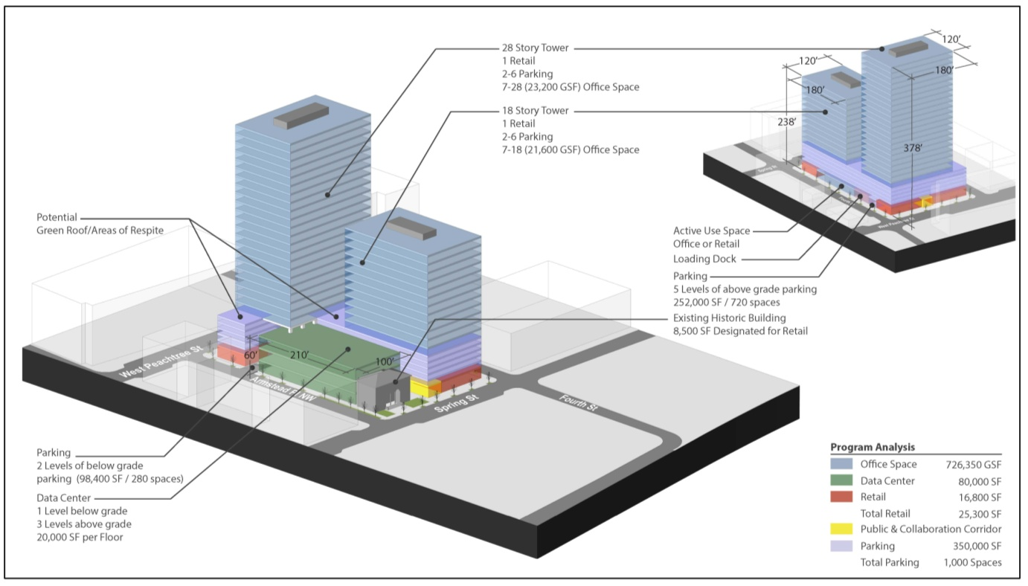
Large Program Concept
Two towers with multiple branding opportunities

Slide 27
Advanced research computing agenda
High Degree of Alignment
OVERALL LEADS
Steve French (CoA)
Sudha Yalamanchili (ECE)
Steve Dewerth (CoE)
Lisa Sills (GTRI)
Don McConnell (GTRI)
PLACE- SPACE,
LOCATION, COMMUNITY,
WASTE HEAT
Collaboration, co-working Startup hosting, water Fountain effect (Starbucks), Midtown Atlanta
Beth Mynatt (IPaT)
Catherine Ross
Carl DiSalvo
SMART BUILDING,
SENSOR NETWORKS, BIM
Building sensors control Waste heat recovery from Data center into offices, Computer controlled lighting And thermostats, sending occupants
Mary Ann Weitnaur (ECE)
Fried Augenbroe (CoA)
Alain Louchez
NETWORK – DATA CENTER, COMMUNITY, INTERNET
Software defined networks, Community technology hosting For economic development, ATDC companies, Global footprint For distributed data centers
Ellen Zegura ( CoC)
Matt Sanders (CTO)
Magnus Egerstedt (ECE)
CYBER-PHYSICAL SYSTEMS
SECURITY
Wenke Lee
Paul Royal
GTISC
SMART GRID,
CONTROL SYSTEMS
Ties smart grid research into computer systems – Clock speed adjusts based on power costs
Rick Hartlein (NEETRAC)
Dimitry Mavris (AE)
Scott Duncan (ASDL)
DATA HOSTING /MANAGEMENT /ANALYTICS/POLICY
Big Data storage, Machine Learning, business analytics, Health care data, materials Genome, combustion research Data
Dana Randall
Sandy Slaughter (CoB)
To be named later
COMPUTER SYSTEMS
Includes Data Center, Computer Architecture, Virtualization, cloud hosting For sensitive data, regional Data center support
Yogi Joshi (ME)
Tom Conti (CoC)
Sudha Yalamanchili (ECE)
The Circle of Research Relationships

Slide 28

Protected Healthcare Information Update
Keep Beth out of jail
Ongoing Research
  Employers Like Me – I3L - employee/employer health data used to bring population health analytics to self insured companies to help manage employee health and costs
  ISyE/Care Inequality Research and Senior Design Project – using CMS Medicaid data to research inequalities in the care delivery system.
  CHOA– contains a rich data warehouse of clinical data for pediatric research.
    Rahul Basole – Careflow Process Research for pediatric asthma patients
    SimTigrate– Process improvement in workflow
  UCB – I3L and Jimeng Sun - using predictive analytic models to provide clinical decision support. Created a data management plan that is being considered for the GTRC template.
Provide a one-stop policy, procedure and security shop for research on health data.
Create a compliant infrastructure for different levels of secure data.
Construct a storehouse of healthcare informatics knowledge.
Streamline and support partnerships with data providers.
Richard Starr richard.starr@gatech.edu

Slide 29
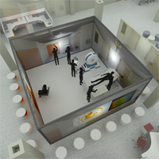
SimTigrate Design Lab: Strategic Partnerships
Military Health System
Process and built environment modeling
of outpatient care and the
Patient Centered Medical Home
Developing metrics for layouts to
prevent patient falls
Johns Hopkins Healthcare
Employing a systems approach to improving sleep and reducing delirium in the ICU
Creating improved bio-containment procedures, systems and settings
Craig Zimring, PhD craig.zimring@gatech.edu

Slide 30



Convergence Innovation Competition
SPRING 2015 TIMELINE
Jan: Tutorials
Feb: Industry open houses
Mar 13: Draft Submission
Mar 16 - 20: Hack break
Apr 10: Final Submissions
Apr 10: GT-L Judging/Awards
Apr 15: CIC Judging/Awards
Fall 2014 CIC
28 Entries
4 Winners
Set to launch this Spring!
Siva Jayaraman – jsiva@gatech.edu

